Slide 1


Green Pace
Security Policy Presentation
Developer: Madeline McNeeley
Threat Analysis: Memory Protection and Static Assertions

Slide 2

OVERVIEW: DEFENSE IN DEPTH
Defense in Depth is a technique that adds security measures in a layered fashion in order to protect the device, network, and sensitive data from malicious attacks.

Slide 3
THREATS MATRIX
Likely Memory Protection | Priority P18
Low priority P1 | Unlikely Assertions

Slide 4
10 PRINCIPLES
Validate Input Data STR50-CPP
Heed Compiler Warnings - MEM52-CPP
Architect and Design for Security Policies
Keep It Simple EXP63-CPP
Default Deny EXP63-CPP , DCL03-C
Adhere to the Principle of Least Privilege INT50-CPP
Sanitize Data Sent to Other Systems STR02-C
Practice Defense in Depth FIO51-CPP
Use Effective Quality Assurance Techniques MSC52-CPP
Adopt a Secure Coding Standard FIO51-CPP, MSC52-CPP

Slide 5
CODING STANDARDS
Memory Protection
Data Type
Data Value
String Correctness
SQL Injection
Assertions
Exceptions
Declaration
Value-Returning Functions

Slide 6
ENCRYPTION POLICIES
Encryption in rest - This type of encryption protects data storage.
Encryption at Flight - Protects data while it transfers locations.
Encryption in use - Protects data during CRUD operations

Slide 7
TRIPLE-A POLICIES
Authentication - The process of verifying a user’s identity through credentials.
Authorization – The security policy that verifies what access and permissions a new or existing user has to the system.
Accounting - the policy that refers to the act of keeping track of changes that happen within the system.

Slide 8
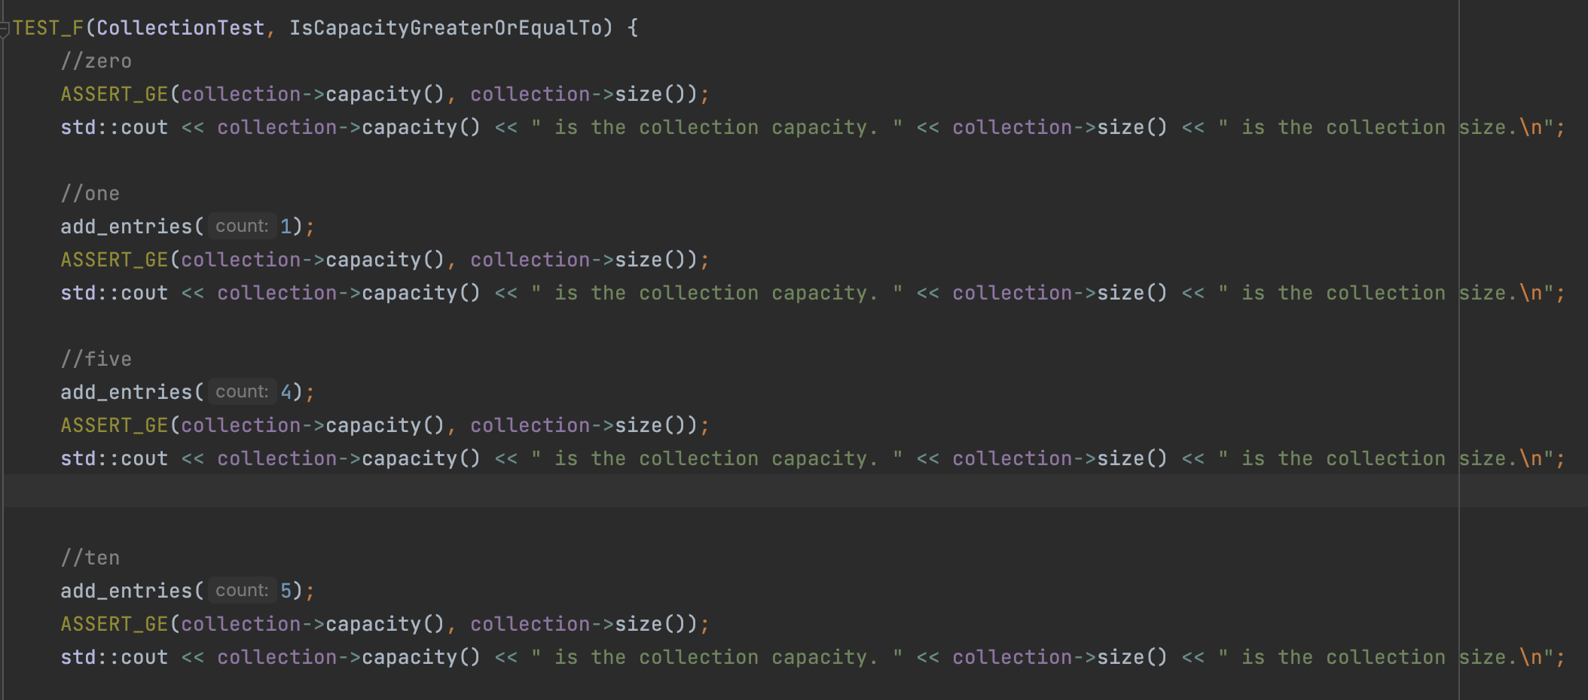
Unit testing: Positive testing 1

Slide 9
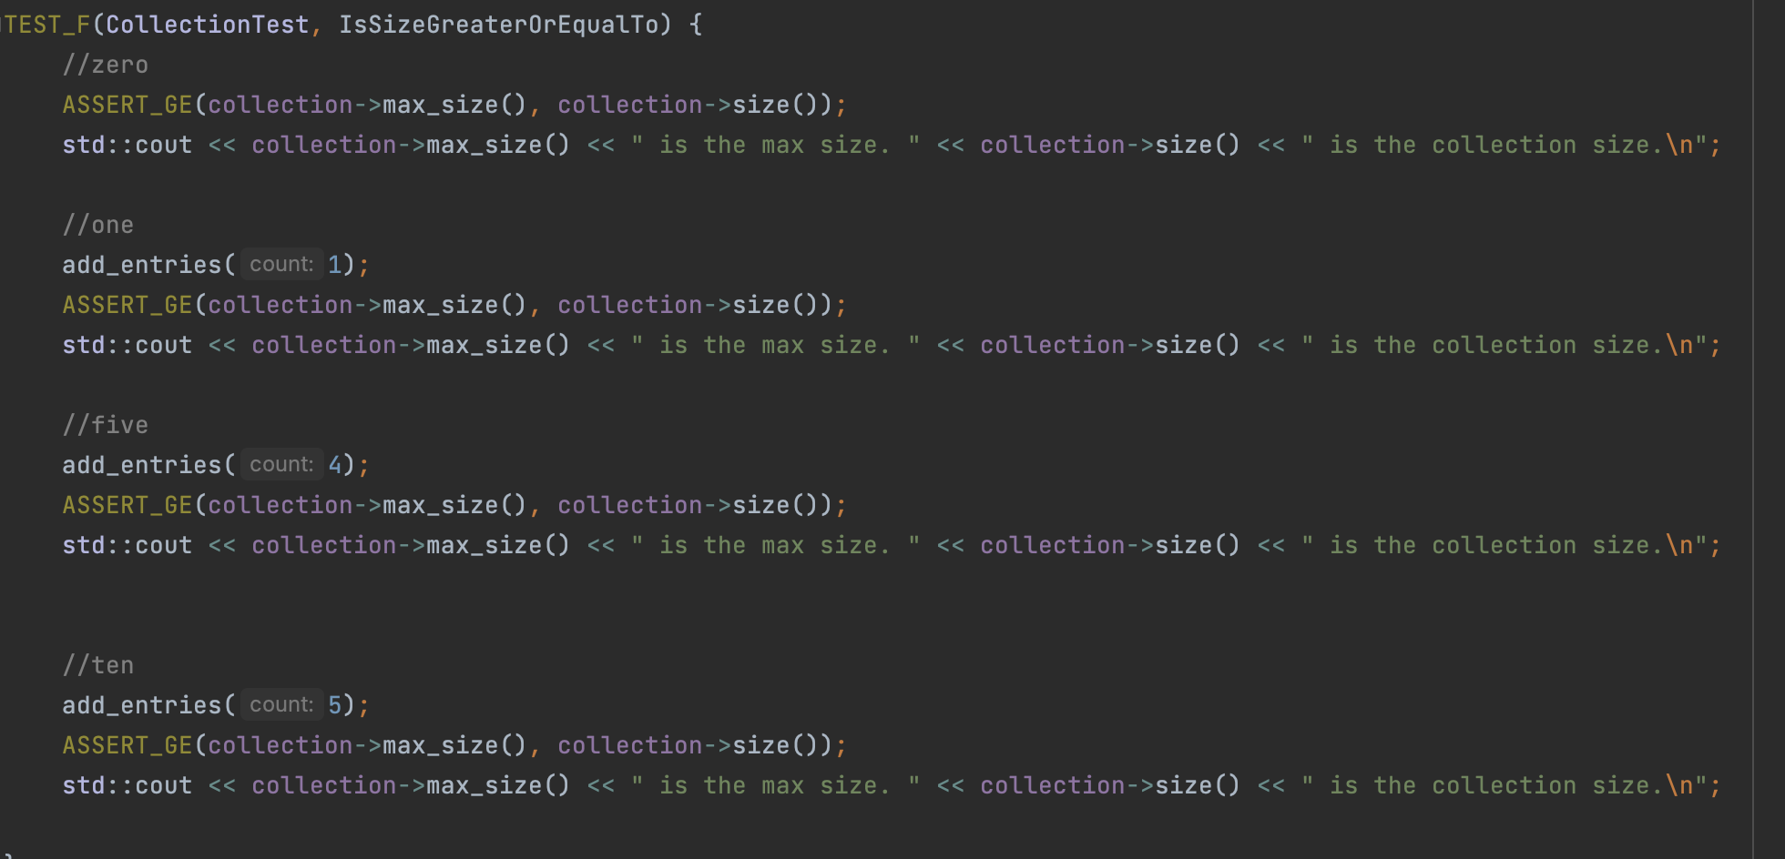
Unit testing: Positive testing 2

Slide 10
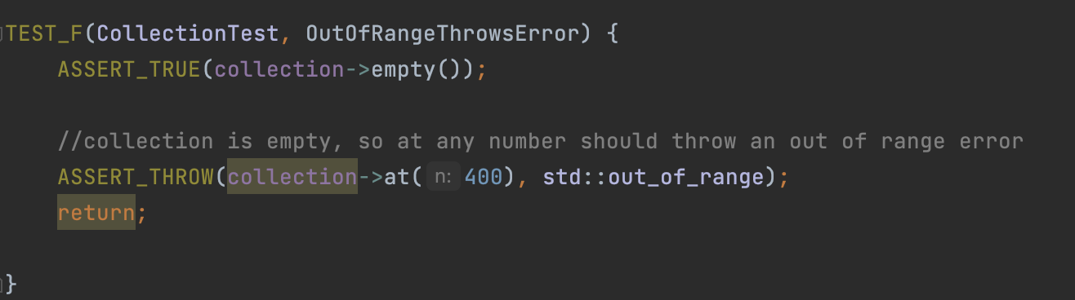
Unit testing: Negative testing 1

Slide 11
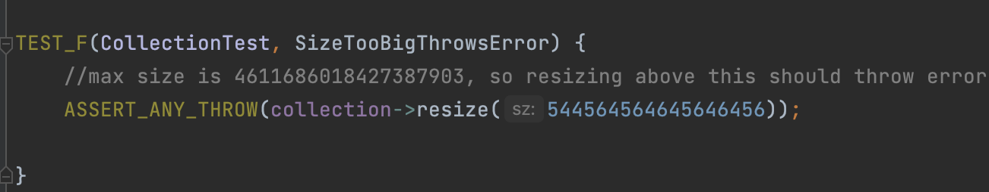
Unit testing: Negative testing 2

Slide 12

AUTOMATION SUMMARY

Slide 13
TOOLS
Static testing: CPP Checker, ClangTidy
Containers: Docker
Unit testing: Gtest
API testing: Postman

Slide 14
RISKS AND BENEFITS
Security breaches become more expensive the longer it takes to identify and address them. This cost can include:
loss of data,
loss of intellectual property,
loss of clients/client trust,
lost time for fixing,
lost wages due to service outages.

Slide 15
RECOMMENDATIONS
Implementing a DiD policy to ensure that, if one layer of security fails there is another one to stop an attack.
Add authentication, authoroization, and accounting measures to know who has access to the system and which parts of the system. As well as a way to identify abnormal activity or use of the system.
Encrypt data at every stage.
Add various tools to identify vulnerabilities faster

Slide 16
CONCLUSIONS
Authentication can prevent hackers from entering the system.
Authorization can stop a hacker who has entered the system from gaining access of the whole system.
Accounting can help identify unusual activity if a breach has occurred.
Adding security earlier in the development process and adding unit testing and static testing in the development stage can help prevent gaps in security.

Slide 17
REFERENCES
Seacord, R. C. (2013). Secure Coding in C and C++ (2nd ed.). Pearson Technology Group. https://bookshelf.vitalsource.com/books/9780132981972

